Slide 1



Course Name software Development project management
CSC 4125
(Undergraduate)
Chapter 9 risk management
Software engineering (Undergraduate)
M. Mahmudul hasan
Assistant Professor, CS, AIUB
http://www.dit.hua.gr/~m.hasan

Slide 2
Risk overview
MMH
The chance of exposure to (introduce) the adverse (opposing) consequences of future events’
Project plans have to be based on assumptions. Risk is the possibility that an assumption is wrong. When the risk happens it becomes a problem or an issue
Risks are potential problems that might affect the successful completion of a software project
Risks involve uncertainty and potential losses
Risk analysis and management are intended to help a software team understand and manage uncertainty during the development process
The important thing is to remember that things can go wrong and to make plans to minimize their impact when they do
The work product is called a Risk Mitigation, Monitoring, and Management Plan (RMMM)

Slide 3
Risk management
MMH
Reactive (Low Risk Impact)
project team reacts to risks when they occur
mitigation—plan for additional resources to reduce the severity of damages
fix on failure—resources are found and applied when the risk strikes
Proactive (High Risk Impact)
formal risk analysis is performed
organization corrects the root causes of risk
examining risk sources that lie beyond the bounds of the software (C=A/B in a loop operation)
developing the skill to manage change

Slide 4
Risk Projection & building a risk table
MMH
Risk projection, also called risk estimation, attempts to rate each risk in two ways
Probability: the likelihood or probability that the risk is real
Consequences: the consequences of the problems associated with the risk, should it occur
The project planner, along with other managers and technical staff, performs four risk projection activities:
Probability: establish a scale that reflects the perceived likelihood of a risk,
Consequences: define the consequences of the risk,
Impact: estimate the impact of the risk on the project and the product,
Accuracy: note the overall accuracy of the risk projection so that there will be no misunderstandings.

Slide 5
Risk component & drivers
MMH
The major risk components (risk categories) are defined in the following manner:
Performance risk: the degree of uncertainty that the product will meet its requirements and be fit for its intended use
Cost risk: the degree of uncertainty that the project budget will be maintained
Support risk: the degree of uncertainty that the resultant software will be easy to correct, adapt, and enhance
Schedule risk: the degree of uncertainty that the project schedule will be maintained and that the product will be delivered on time
The impact of each risk driver on the risk component is divided into one of four impact categories— negligible, marginal, critical, or catastrophic

Slide 6
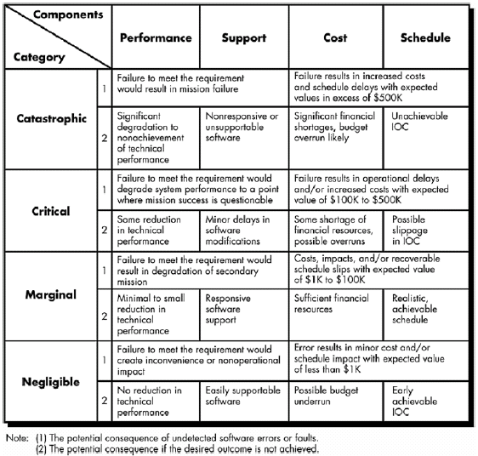
Impact assessment – table-1
MMH

Slide 7
Risk check list
MMH
Product size (PS) — risks associated with the overall size of the software to be built or modified
Business impact (BU) — risks associated with constraints imposed by management or the marketplace
Customer characteristics (CU) — risks associated with the sophistication of the customer and the developer's ability to communicate with the customer in a timely manner
Process definition (PR) — risks associated with the degree to which the software process has been defined and is followed by the development organization [autopilot performance fixing with XP]
Development environment (DE) — risks associated with the availability and quality of the tools to be used to build the product [resource allocation plan]
Technology to be built (TE) — risks associated with the complexity of the system to be built and the "newness" of the technology that is packaged by the system
Staff size and experience (ST) — risks associated with the overall technical and project experience of the software engineers who will do the work

Slide 8
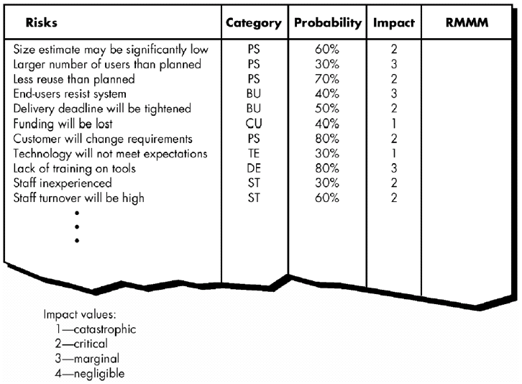
Building risk table - 2
MMH
RMMM = Risk Mitigation, Monitoring and Management Plan

Slide 9
Assessing risk impact
MMH
The following steps are recommended to determine the overall consequences of a risk:
determine the average probability of occurrence value for each risk component.
determine the impact for each component based on the criteria shown (table. 1)
complete the risk table and analyze the results
The overall risk exposure, RE, is determined using the following relationship:
RE = P x C
where P is the probability of occurrence for a risk, and C is the cost to the project should the risk occur.

Slide 10
Assessing risk impact
MMH
Assume that the software team defines a project risk in the following manner: Risk identification. Only 70% of the software components scheduled for reuse will, in fact, be integrated into the application. The remaining functionality will have to be custom developed.
Risk probability. 80% (likely).
Risk impact. 60 reusable software components were planned. If only 70 percent can be used, 18 components would have to be developed from scratch (in addition to other custom software that has been scheduled for development). Since the average component is 100 LOC and local data indicate that the software engineering cost for each LOC is $14.00, the overall cost (impact) to develop the components would be 18 x 100 x 14 = $25,200.
Risk exposure. RE = 0.80 x 25,200 ~ $20,200.

Slide 11
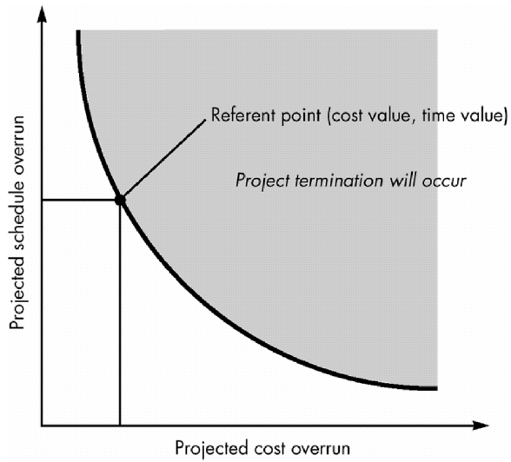
Risk assessment
MMH
For assessment to be useful, a risk referent level must be defined.
In the context of software risk analysis, a risk referent level has a single point, called the referent point or break point, at which the decision to proceed with the project or terminate it (problems are just too great) are equally weighted.

Slide 12
A framework for dealing with risk - risk management
MMH
Risk identification – what risks might there be?
Risk analysis and prioritization – which are the most serious risks?
Risk planning – what are we going to do about them?
Risk monitoring – what is the current state of the risk? Must be an ongoing activity, as the importance and likelihood of particular risks can change as project proceeds.

Slide 13
Risk identification
MMH
Approaches of identify risks include:
Use of checklists – usually based on the experience of past projects. Some risk are generic risk, they are relevant to all software projects. A standard checklist can be used to identify the risks (e.g. changing technology).
Brainstorming – getting knowledgeable stakeholders together to pool concerns
Causal mapping – identifying possible chains of cause and effect. For example, illness of a team member is a risk that might put the project completion date at risk and result in the late delivery of the product

Slide 14
Boehm’s top 10 development risks
MMH
Risk | Risk reduction techniques
Personnel shortfalls | Staffing with top talent; job matching; teambuilding; training and career development; early scheduling of key personnel
Unrealistic time and cost estimates | Multiple estimation techniques; design to cost; incremental development; recording and analysis of past projects; standardization of methods
Developing the wrong software functions | Improved software evaluation; formal specification methods; user surveys; prototyping; early user manuals
Developing the wrong user interface | Prototyping; task analysis; user involvement

Slide 15
Boehm’s top 10 development risks
MMH
Risk | Risk reduction techniques
Gold plating | Requirements scrubbing (cleaning), prototyping, design to cost
Late changes to requirements | Change control, incremental development
Shortfalls in externally supplied components | Benchmarking (evaluate by comparison with standard), inspections, formal specifications, contractual agreements, quality controls
Shortfalls in externally performed tasks | Quality assurance procedures, competitive design
Real time performance problems | Simulation, prototyping, tuning
Development technically too difficult | Technical analysis, cost-benefit analysis, prototyping , training

Slide 16
Risk prioritization
MMH
Risk exposure (RE) = (potential damage) x (probability of occurrence)
Ideally
Potential damage: a money value (e.g. a flood would cause $0.5 millions of damage)
Probability: 0.00 (absolutely no chance) to 1.00 (absolutely certain)
e.g. 0.01 (one in hundred chance)
RE = $0.5m x 0.01 = $5,000
Approximately equivalent to the amount needed for an insurance premium

Slide 17
Risk exposure example
MMH
Ref | Hazard | Likelihood | Impact | Risk Exposure
R1 | Changes to requirements specification during coding | 8 | 8 | 64
R2 | Specification takes longer than expected | 3 | 7 | 21
R3 | Significant staff sickness affecting critical path activities | 5 | 7 | 35
R4 | Significant staff sickness affecting non-critical activities | 9 | 3 | 27
R5 | Module coding takes longer than expected | 4 | 5 | 20
R6 | Module testing demonstrates errors or deficiencies in design | 4 | 8 | 32

Slide 18
Risk probability: qualitative descriptors
MMH
Probability level | Range
High | Greater than 50% chance of happening
Significant | 30-50% chance of happening
Moderate | 10-29% chance of happening
Low | Less than 10% chance of happening

Slide 19
Risk impact: qualitative descriptors
MMH
Qualitative descriptors of impact on cost and associated range values
Impact level | Range
High | Greater than 30% above budgeted expenditure
Significant | 20 to 29% above budgeted expenditure
Moderate | 10 to 19% above budgeted expenditure
Low | Within 10% of budgeted expenditure

Slide 20
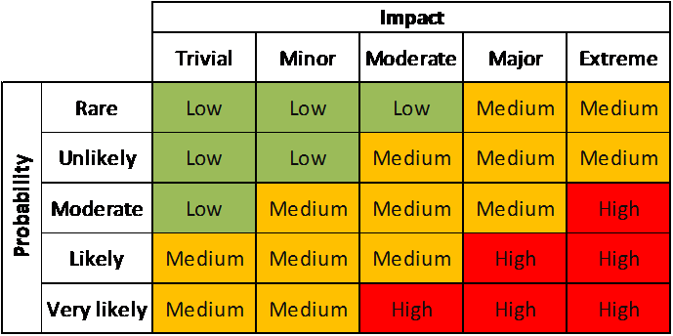
Probability-impact matrix
MMH

Slide 21
Risk planning
MMH
Risks can be dealt with by:
Risk prevention/avoidance – a project can, for example, be protected from the risk of overrunning the schedule by increasing duration estimates or reducing functionality.
Risk reduction – some risk, while they cannot be prevented, can have their likelihoods reduced by prior planning. The risk of late changes to a requirements specification can, for example, be reduced by prototyping but will not eliminate the risk of late changes.
Risk transfer – the impact of some risk can be transferred away from the project, by, for example, contracting out or taking out insurance.

Slide 22

Risk reduction leverage (RRL)
MMH
Risk Reduction Leverage is another Quantitative means of assessing how Risks are being managed
RE_{before} is risk exposure before risk reduction e.g. 20% chance of a fire causing $20,000 damage
RE_{after} is risk exposure after risk reduction e.g. fire alarm costing $1500 reduces probability of fire damage to 5%
RRL = (0.2x20,000) – (0.05x20,000) /1500 = 4,000 – 1,000 / 1500 = 2
RRL > 1.00 therefore worth doing

Slide 23
Evaluating Risk to the schedule
MMH
Using PERT (Program Evaluation Review Technique) to evaluate the effects of uncertainty: there are 3 estimates are produced for each activity
Most likely time (m) – the time we would expect the task to take under normal circumstance
Optimistic time (a) – the shortest time in which we could expect to complete the activity, barring outright miracles.
Pessimistic (b) – the worst possible time allowing for all seasonable eventualities.
‘expected time’ te = (a + 4m +b) / 6
‘activity standard deviation’ S = (b-a)/6

Slide 24
Evaluating Risk to the schedule
MMH
Task A
Task B
Task C
What would be the expected duration of the chain A + B + C?
12.33 + 10.33 + 25.66 = 48.65
What would be the standard deviation for A + B+ C?
Square root of (1² + 1² + 3²) = 3.32
Task | a | m | b | t_{e} | s
A | 10 | 12 | 16 | 12.33 | 1
B | 8 | 10 | 14 | 10.33 | 1
C | 20 | 24 | 38 | 25.66 | 3

Slide 25
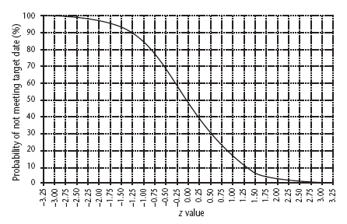
Assessing the likelihood of meeting a target
MMH
Say the target for completing A+B+C was 52 days (T). Calculate the z value. z = (T – te)/s
In this example, z = (52 - 48.33)/3.32 = 1.01
There is about a 17% chance of not meeting the target of 52 days.

Slide 26
Problem with estimates of task duration
MMH
Estimators add a safety zone to estimate to take account of possible difficulties (risk avoidance)
Developers work to the estimate + safety zone, so time is lost
No advantage is taken of opportunities where tasks can finish early – and provide a buffer for later activities (e.g. Float = time between earliest finish and latest finish )

Slide 27
Risk due to product size
MMH
Attributes that affect risk:
estimated size of the product in LOC or FP
estimated size of product in number of programs, files, transactions
percentage deviation in size of product from average for previous products
size of database created or used by the product
number of users of the product
number of projected changes to the requirements for the product, before delivery and after delivery
amount of reused software

Slide 28
Risk due to business impact
MMH
Attributes that affect risk:
effect of this product on company revenue (e.g. reuse leads to lower s/w price)
reasonableness of delivery deadline
number of customers who will use this product
interoperability constraints
governmental constraints
costs associated with late delivery
costs associated with a defective product

Slide 29
Risk due to customer
MMH
Questions that must be answered:
Have you worked with the customer in the past?
Does the customer have a solid idea of requirements?
Has the customer agreed to spend time with you?
Is the customer willing to participate in reviews?
Is the customer technically sophisticated?
Is the customer willing to let your people do their job—that is, will the customer resist looking over your shoulder during technically detailed work?
Does the customer understand the software engineering process?

Slide 30
Risk due to process maturity
MMH
Questions that must be answered:
Have you established a common process framework?
Is it followed by project teams?
Do you have management support for software engineering?
Do you have a proactive approach to SQA?
Do you conduct formal technical reviews?
Are CASE (computer aided software engineering) tools used for analysis, design and testing?
Are the tools integrated with one another?
Have document formats been established?

Slide 31
Technology Risk
MMH
Is the technology new to your organization?
Are new algorithms, I/O technology required?
Is new or unproven hardware involved?
Does the application interface with new software?
Is a specialized user interface required?
Is the application radically different from the pervious?
Are there significant performance constraints?
Is there doubt the functionality requested is "do-able?"

Slide 32
references
MMH
Bob Hughes and Mike Cotterel (1999). Software Project Management (Second Edition).
PMBOK Guide: Project Lifecycle (5th Edition)

